Slide 1
ECOE PLATFORM
PO – PM : Mr. Kent

Slide 2
How to work in the team
The Front-End team has a meeting for discussing features and unifying the results .
The Front-End team will bring results to discuss with Back-End team and to unify features that will make upcoming tasks.
The Back-End team will make APIs or data for supporting the Front-End.
A bi-weekly meeting, will take place on Wednesday, with boss (Mr. Kent) to report on project status. The purpose meeting is as follow:
What has the team done?
What will the team do?
What prevents the team from performing works as well as possible?

Slide 3
Organization Chart
Note:
Dev ??? : is missing position
Mr. Kent
(PM)
LocLD
(Team Leader)
Front-End
HaoPP
(Back-End)
Dev ???
Android Dev
Dev ???
IOS Dev
Dev ???
(Back-End)
Dev ???
(Back-End)

Slide 4
FRONT-END TEAM

Slide 5
BACK-END TEAM

Slide 6
Organization Chart – Back-End team
LocLD
(Team Leader)
HaoPP
(Back-End)
Dev ???
(Back-End)
Dev ???
(Back-End)
Dev ???
Android Dev
Dev ???
IOS Dev
Note:
Dev ??? : is missing position

Slide 7

Master Planning – Back-End team
 | Project milestone
Project Summary | 3-Jun-19 | 14-Jun-19 | 17-Jun-19 | 28-Jun-19 | 1-Jul-19 | 12-Jul-19 | 15-Jul-19 | 26-Jul-19 | 29-Jul-19 | 9-Aug-19 | 12-Aug-19 | 23-Aug-19
Build Microservice system
Product Service
Mutual Space Service
Searching Service
History Service
Account Service
Notification Service

Slide 8
Content
Technical stack
Solution architecture
Product service
OAuth service
Notification service
Mutual Space Service
Promotion Service
Helpdesk Service

Slide 9
Reference Document
Reference document:
Excel1: R1-Features-UIUX-ECOE-010519.xls
Excel2: ECOE brainstorm _v13_ECOE.xls

Slide 10


























Technical Stack
DATABASES
Analytics AI / ML
DEVELOPER
DEVOPS, IT & MONITORING

Slide 11


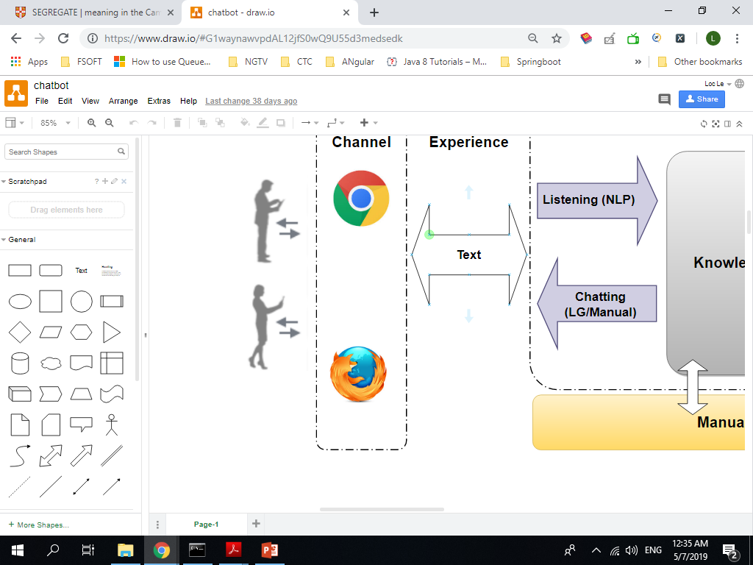
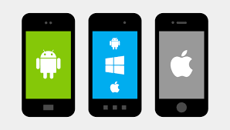
Solution Architecture
Event Bus
API
Gateway
Identity Provider
MICROSERVICES
External Service
Mutual Space Service
Account Service
Product Service
News Service
Promotion Service
Statistics Service
Search Service
Customer Service
Helpdesk Service
Recommendation Service
Notification Service
Database Cluster

Slide 12
BACK-END DETAIL DESIGN ARCHITECTURE

Slide 13
Product Service
Product Category API
Add Category
Update Category
List Category
Delete Category
Product API
Add Product
Update Product
Delete Product
Get Product By Id
Paging products
Filter/Search product by criteria
List (paging) Hidden products by user
List (paging) Other products by user
Publish Products by user to one broker
Publish Products by user to brokers
Outstanding product conditions API
Add
Delete
Update
Reads
Writes
Primary
Replication
Replication
Secondary
Heartbeat
Secondary
Solution architecture

Slide 14

History Service
History API
Add Product by viewer
Update Product by viewer
Delete Product by viewer
List products by viewer
List history of Brokers
Sources
Streams
Messaging
Stream
Processing
NoSQL
Database
Topic 1
Topic 2
Topic n
Solution architecture

Slide 15
Mutual Space Service
List The newest Products
List Featured products
List Favorite products
List Ecoe products
View detail of product
Reads
Writes
Primary
Replication
Replication
Secondary
Heartbeat
Secondary

Slide 16
Search Service
Filter/Search by criteria
Filter/Search by content
Ingest process
Data Ingestion process
Solution architecture

Slide 17

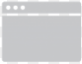
News Service
Q&A API
Paging QnA
Filter/Search QnA
Add QnA
Update QnA
Publish QnA
News API
Paging News
Filter/Search News
Add News
Update News
Publish News
Share news over social network
APIs
Administration Interface
Content Repository

Slide 18
Notification Service
Send notification messages
Send mail
Distribute messages
Notification
Solution architecture

Slide 19

OAuth Service
Protect Network
Internet
Create Account
Update Profile
Active Account
Deactivate Account
List(Paging) accounts
List (Paging) accounts (brokers)
Create brokers (account) directory by user
Update brokers (account) directory by user
Delete brokers (account) directory by user
API Gateway
APIs
Token
Token
(if needed)
OAuth
Solution architecture

Slide 20
Customer Service
Customer API
Add Customer
Update Customer
Delete Customer
List Customer
Find Customer By Id
Filter/ Search customer by criteria
Filter/ Search customer by content

